Slide 1
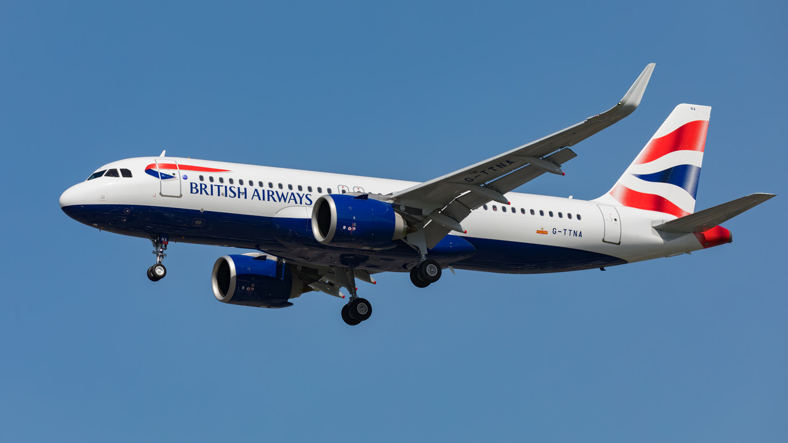
British Airways Customers’ Reviews Analysis

Slide 2
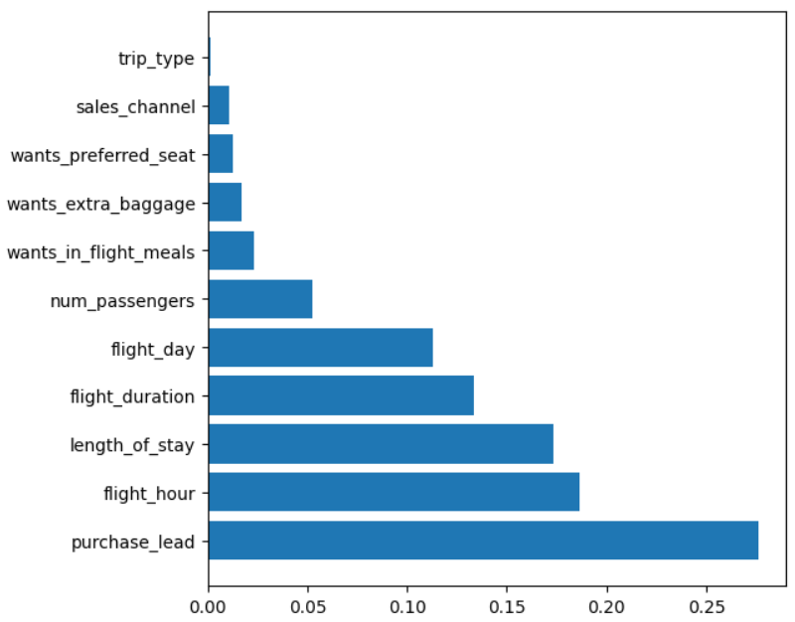
Predictive Model to understand pattern of flights booking
Random Forest classifier algorithm was trained on dataset producing accuracy of 84.3%, F1 Score of 0.096, and
ROC AUC of 0.518.
Knowing that the feature importance interpret that:
purchase_lead
flight_hour
length_of_stay
flight_duration
flight_day
Are the most important features affecting customer competition to the booking.

